Slide 1

Green Pace
Security Policy Presentation
Developer: Kyle Gaskill

Slide 2

OVERVIEW: DEFENSE IN DEPTH
A security policy outlining defense in depth is ultimately important when it comes to effectively defending your entire system from threats as effectively as possible.

Slide 3
THREATS MATRIX
STD-001-CPP | High | Unlikely | Medium | High | 2
DCL52-CPP | Low | Low | Unlikely | P3 | L3
DCL53-CPP | Low | Unlikely | Medium | P2 | L3
STR52-CPP | High | Probable | High | P6 | L2
STR02-C | High | Likely | Medium | P18 | L1
MEM52-CPP | High | Likely | Medium | P18 | L1
MSC11-C | Low | Unlikely | High | P1 | L3
ERR51-CPP | Low | Probable | Medium | P4 | L3
MEM53-CPP | High | Likely | Medium | P18 | L1
DCL55-CPP | Low | Unlikely | High | P1 | L3
INT32-C | High | Likely | High | P9 | L2
With the threats matrix displaying medium to high remediation costs as they account for errors found in validation of input that most result in undefined/unwanted behavior from the code. Common issues can be found from the data types being qualified, string correctness with use of valid pointers and references, as well as memory handling and memory overload.

Slide 4
10 PRINCIPLES
Validate Input Data
Heed Compiler Warnings
Architect and Design for Security Policies
Keep it simple
Default Deny
Adhere to the Principle of Least Privilege
Sanitize Data Sent to the Other Systems
Practice Defense in Depth
Use Effective Quality Assurance Techniques
Adopt a Secure Coding Standard
Coding Standard 1: Validate Data Input
Coding Standard 2: Validate input data
Coding Standard 3: Validate input data, sanitize data sent to other systems and Keep it simple.
Coding Standard 4: Sanitize Data Sent to Other systems and Validate input.
Coding Standard 5: Heed compiler warnings
Coding Standard 6: Architect and Design for Security Policies, heed compiler warnings, input validation.
Coding Standard 7: Heed compiler warnings
Coding Standard 8: Sanitize data sent to other systems, keep it simple.
Coding Standard 9: Input validation and sanitize data sent to other systems.
Coding Standard 10: Input validation.

Slide 5
CODING STANDARDS
Default Deny
Architect and Design for Security Policies
Validate input data
Sanitize data sent to other systems
Adhere to the principle of least privilege.
Heed Compiler Warnings
Practice Defense in Depth
Adopt a secure coding standard
Use Effective Quality Assurance techniques
Keep it simple
Systems and software that default deny access to higher functions/data can help secure a system from the start when only certain credentials can be assigned a given command or access permission. Architect and design for security is vital since it is the planning of what security policies are needed to secure the software you intend to build. Planning a head can often lead to a more secure program. Validate input data is important when it comes to protecting data sources, file networks and command lines from improperly sent commands for exploiting a system. Data should always be sanitized before being sent to other systems so complex systems can be protected from SQL injections. PolP is important when securing software and data. If users access and credentials are only given on a need basis will help protect the security by not giving every user account the same access in the event of a compromised account. Heed compiler warnings to help protect the systems workings by releasing too much information if an error is not handled properly. Also will protect from certain exploits that are not double checked. Practice defense in Depth is important for the multiple defensive strategies that can be designed around a system. Adopt a secure coding standard follows this in importance since it goes hand in hand with DiD. Having effective QA techniques can protect a system by catching bugs and exploits that pentesters look for. Lastly, keep it simple, make sure the code is simple design and is easier for users to interact and accept it when reviewing.

Slide 6
ENCRYPTION POLICIES
Encryption at rest is the design process of preventing attackers from accessing unencrypted data by making sure all data on a system or disk is encrypted.
Encryption at flight is the process of encrypting data being transmitted between systems. This gives your system integrity when data is being moved from one place before it is decrypted on the other side for authorized users and prevents unauthorized users from intercepting data.
Encryption in use is a similar to the principal of least privilege by restricting data by a user’s authentication credentials and keeping it secured to others without the proper credentials.

Slide 7
TRIPLE-A POLICIES
Authentication is the process of a system comparing a user’s credentials with a database confirming this user’s credentials match and is permitted access to certain features or systems. This would be for users who need to access sensitive systems that contain important privileges or information that not all users should have access to.
Authorization is given after a user is authenticated and granted privileges granted per that user. This prevents resources from being over permitted which could cause security concerns and only gives the amount of resources a user’s role needs to be able to perform their duty/tasks.
Accounting is like accountability for a user for which a system monitors the resources used by the user during their time in the system.

Slide 8
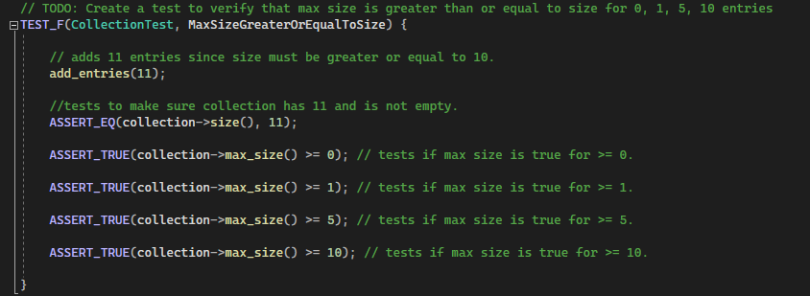

Unit Testing
MaxSizeGreaterOrEqualToSize – tests to make sure the size did not overflow and that the Max size is always greater to the current size. This helps make sure the program is working as intended.

Slide 9
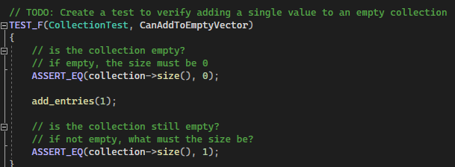
Unit Testing
CanAddToEmptyVector – tested to make sure empty collections could have entries added to it correctly without causing any issues. This is to make sure the program is working as intended and not having any unwanted behaviors.

Slide 10
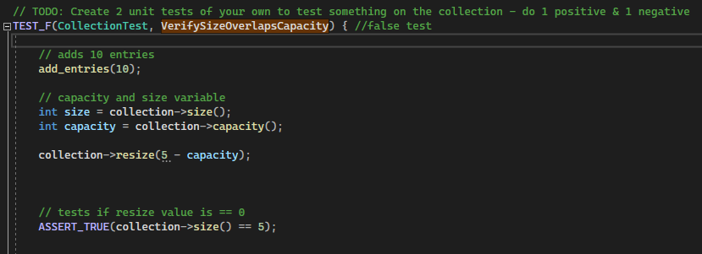
Unit Testing
VerifySizeOverlapsCapacity – failed test to see if capacity can be resized based on size comparison.

Slide 11
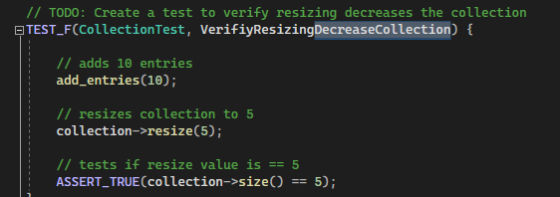
Unit Testing
VerifyResizingDecreaseCollection – Adds 10 entries to start then resizes collection by 5 and returns positive result when finished.

Slide 12

AUTOMATION SUMMARY

Slide 13
TOOLS
When it comes to DevSecOps, automation is a critical component of ensuring rapid successful deployment of the standards defined by development, security and operations. Automation improves development by assisting software engineers with the detection of security threats in a quicker succession than a human user manually searching for them. With this time being saved, the automation gives better feedback quickly to start developing fixes that are designed, built, tested, and deployed. Security in automation allows the system to rapidly detect incidents as they happen and can handle them automatically by using pre-set action plans to given scenarios. For instance, a denial service causing memory load issues could have the system shut down access from the outside or take a system offline temporarily to flush the memory errors being generated. This would reduce the need for human response to manually addressing security issues. Operations in automation allow better consistency and accuracy by monitoring and detecting logs, analytics and event alerting for intrusion.
The phases of DevSecOps tools pipeline is Plan, Code, Build, Test, Release, and Deploy. During the code phase while code is being pre-committed can trigger security tests through security tools. The build phase uses third party code-dependencies utilizes code reviews to scan these dependencies for vulnerabilities. The test phase is when the compiler runs the code tests in certain environments.

Slide 14
RISKS AND BENEFITS
With potential SQL injection through validating input. Checking over variable validation by users inputting strings or numbers in the system can prevent vulnerabilities and can increase security over data and the internal workings of the system. Risks of leaving these vulnerabilities unchanged can cause users to access data or commands not intended to be accessed. Benefits involve having a more secure system with less unintended behavior for users.

Slide 15
RECOMMENDATIONS
Some gaps noted in the security policy are the network handling for security from external threats.
Physical security threats should be considered when thinking about access controls to the environment in which the software is ran.
More end point security for vulnerability scanning for threats, including but not limited to viruses and malware.

Slide 16
CONCLUSIONS
Default Deny and Adhere to principal of least privilege is important policy to adapt to for continued security of the programs administrative commands.
Practice Defense in Depth for a more structured security plan around network layered defenses, anti virus handling, and traffic monitoring.
More in-depth usage of Quality Assurance techniques for rigorous testing of the layered defenses and intended behavior validation.

Slide 17
REFERENCES
Atlassian. (n.d.). DevSecOps Tools. Atlassian. Retrieved February 18, 2022, from https://www.atlassian.com/devops/devops-tools/devsecops-tools.

